Slide 1
Latin American restaurant franchise
Your best location in Houston TX

Slide 2
ABOUT US
We’re on of the leading Business consulting firms in America.
Our analytics team specializes in sourcing the best potential locations for Brick & Mortar businesses across the country.

Slide 3
Why Houston?
Latin American Restaurant Franchise

Slide 4
Why Houston?
The City of Houston, is one of the most populous city in the state of Texas. It is diverse and has a large population of Latin America origin inhabitants. Texas State is famous for their business friendly environment and It provides lot of opportunities. It has attracted many different players into the market. It is a global hub of business and commerce. The city is a major center for Oil & Gas, banking and finance, retailing, world trade, real estate, advertising, legal services, accountancy and engineering. This also translates into a highly competitive business environment.

Slide 5
Latin American restaurant franchise – Business Problem
We need to help a you as inventors, to decide about the best location to open a Latin American Food Restaurant in the City of Houston. The city has a large pool of potential patrons, and it’s relatively large Latino population could make opening a Latin Restaurant a promising business opportunity; nevertheless due to its geographical extension and disparity of incomes among its population. Makes the restaurant location choice, a key factor for the restaurant commercial viability.

Slide 6
Latin American restaurant franchise – Considerations
So it is evident that to survive in such market, it is very important to strategically plan the best possible location for the venue. Various factors need to be studied in order to decide on the Location such as :
Houston Population & Demographics
Surrounding venues like Gyms, Entertainment zones, Parks, malls, Offices, etc.
Who are the competitors in that location?
Cuisine of the competitors

Slide 7
Latin American restaurant franchise – Considerations
In short the investor determined that the Target Audience for the restaurant would be the Latino Houston residents.
To recommend the correct location, is key to identify the neighbourhoods with the highest number of Latino population and Income data for such target audience would be considered key factor for making our recommendation.

Slide 8
SOLUTION
Based in a pool of data analytics we will determine our recommendation of neighbourhood choice to the Group of investors, based on the relative scarcity of similar restaurants in that location, and the potential size & Average income of the Latin Population (target market) in the targeted neighbourhoods.

Slide 9
Project description
Data to be used
Data 1 : Neighborhood has a total of 88 neighborhoods. In order to segment the neighborhoods and explore them, we will essentially need a dataset that contains the 88 Houston’s neighborhoods as well as the coordinates (latitude and longitude) for each of them. This dataset exists for free on the web. Link to the dataset is : https://en.wikipedia.org/wiki/List_of_Houston_neighborhoods
Data 2 : For the required analysis we will get data from following sources as given below :
Houston Neighbourhoods: https://opendata.arcgis.com/datasets/f50cc53c15bf4fb3940ab6e8c2534f3d_2.csv
Houston Hispanic Population by neighbourhood: https://opendata.arcgis.com/datasets/f50cc53c15bf4fb3940ab6e8c2534f3d_2.csv
Houston Income (including Hispanics) data:http://www.houstontx.gov/planning/Demographics/docs_pdfs/SN/Median_Household_Income_by_SN.pdf

Slide 10
Project description
Data to be used
Data 3 : Houston geographical coordinates data will be sourced from Geocoder package and will be utilized as input for the Foursquare API, that will be leveraged to provide venue information for each neighborhood. We will use the Foursquare API to explore neighborhoods in Houston. The below is image of the Foursquare API data. Additionally we will be using Geocoder Folium & Bautiful Soup to facilitate the attribution of coordinates on data sourced from the 2010 Census database (GIS). For data in Acrobat format (*.pdf) we will extract data using Tabula and wrangling the data using pandas.

Slide 11
Project description
Analysis
We obtained the USA 2010 census data for obtaining the population ethnicity per Houston Neighborhood. We wrangled the data and obtained the Neighborhood coordinates.
Then using FourSquare data we obtained the top10 businesses for each neighbourhood. We clustered in 3 distinctive (using Kmeans) Nighborhood clusters based on restaurant information and data.
Afterwards, we sourced the Median Income Neighborhood data and we merged the data wit the clustered dataframes so to obtain a dataset containing the required demographic information.
Finally we created a weighted score based on Latino Population and Income per neighborhood to select the top 10 Neighborhoods in which we would perform a detailed analysis on the top 10 venues and base our recommendation accordingly.

Slide 12



Results
Top 10 Latino Populated Neighbourhoods in Houston
Our recommendation
Top 10 Most Valuable potential Market for Latino Populated Neighbourhoods in Houston

Slide 13
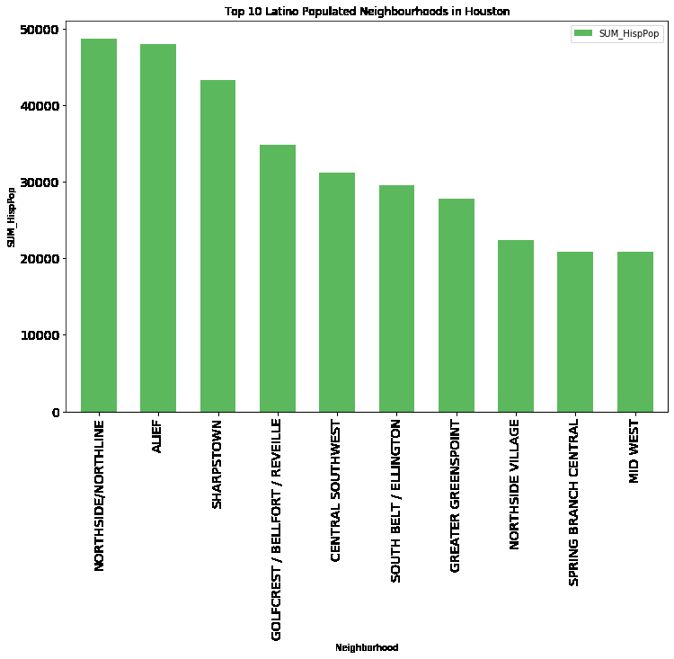
Top 10 Latino Populated Neighbourhoods in Houston

Slide 14
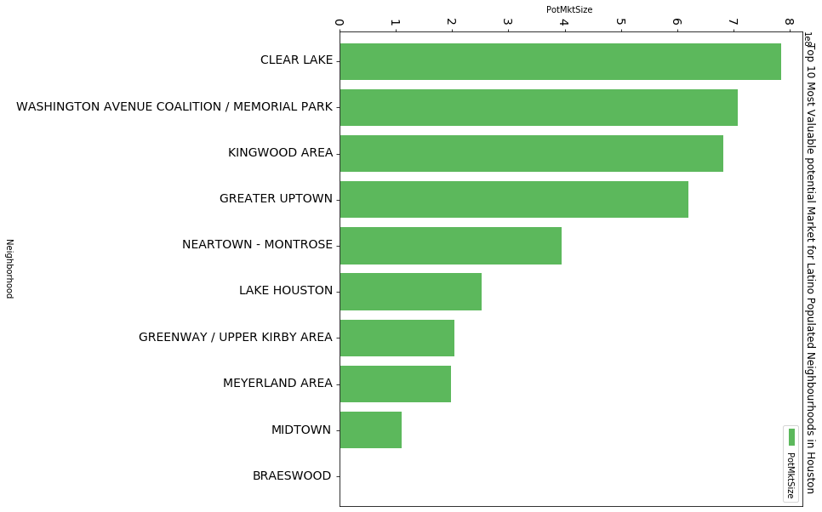
Top 10 Most Valuable potential Market for Latino Populated Neighbourhoods in Houston

Slide 15
Top 3 Ranked Neighborhoods- Top Venues
 | Neighborhood | 1st Most Common Venue | 2nd Most Common Venue | 3rd Most Common Venue | 4th Most Common Venue | 5th Most Common Venue | 6th Most Common Venue | 7th Most Common Venue | 8th Most Common Venue | 9th Most Common Venue | 10th Most Common Venue
11 | CLEAR LAKE | Boutique | Spa | Playground | Salon / Barbershop | Outdoors & Recreation | Dry Cleaner | Flea Market | Financial or Legal Service | Filipino Restaurant | Fast Food Restaurant

Slide 16
Top 3 Ranked Neighborhoods- Top Venues
 | Neighborhood | 1st Most Common Venue | 2nd Most Common Venue | 3rd Most Common Venue | 4th Most Common Venue | 5th Most Common Venue | 6th Most Common Venue | 7th Most Common Venue | 8th Most Common Venue | 9th Most Common Venue | 10th Most Common Venue
73 | WASHINGTON AVENUE COALITION / MEMORIAL PARK | Construction & Landscaping | Video Store | Mexican Restaurant | Zoo Exhibit | Electronics Store | Food | Flower Shop | Flea Market | Financial or Legal Service | Filipino Restaurant

Slide 17
Top 3 Ranked Neighborhoods- Top Venues
 | eighborhood | 1st Most Common Venue | 2nd Most Common Venue | 3rd Most Common Venue | 4th Most Common Venue | 5th Most Common Venue | 6th Most Common Venue | 7th Most Common Venue | 8th Most Common Venue | 9th Most Common Venue | 10th Most Common Venue
38 | KINGWOOD AREA | Pizza Place | Sandwich Place | Fast Food Restaurant | Burger Joint | Fried Chicken Joint | Coffee Shop | Chinese Restaurant | Pharmacy | Shipping Store | Taco Place

Slide 18
Our recommendation
As per the information analyzed and the Market sizes it seems clear that the Latin American restaurant could be make good business sense in any of the top 3 Super Neighborhoods we identified above (CLEAR LAKE, WASHINGTON AVENUE COALITION / MEMORIAL PARK & KINGWOOD AREA).
Nevertheless, CLEAR LAKE seems to offer a larger potential market with less competition from other Latin American restaurants. The area near Wilson Memorial Park (Gilpin Street) looks very suitable (Subject to planning approvals) for a restaurant location.
This will be our preferred recommended location for the potential investors in the restaurant.

Slide 19
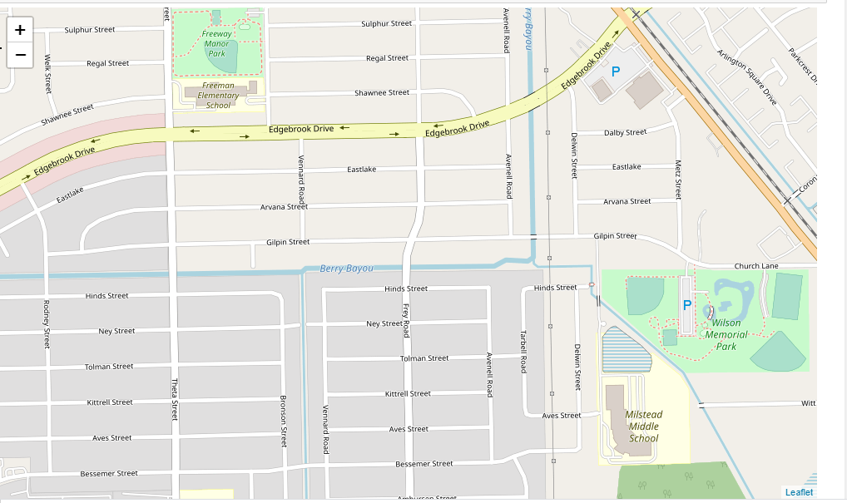
Our recommendation

Slide 20
THANK YOU!

